Slide 1


Final Engagement
Attack, Defense & Analysis of a Vulnerable Network
Presentation by Muhammed Jawara, Mitch Murov, Kevin Alvarado, and Symantha Meyers.
Presented January 26, 2021

Slide 2
Table of Contents
This document contains the following resources:
Network Topology & Critical Vulnerabilities
Exploits Used
Avoiding Detect
Maintaining Access

Slide 3

Network Topology
& Critical Vulnerabilities
Muhammed Jawara
3

Slide 4
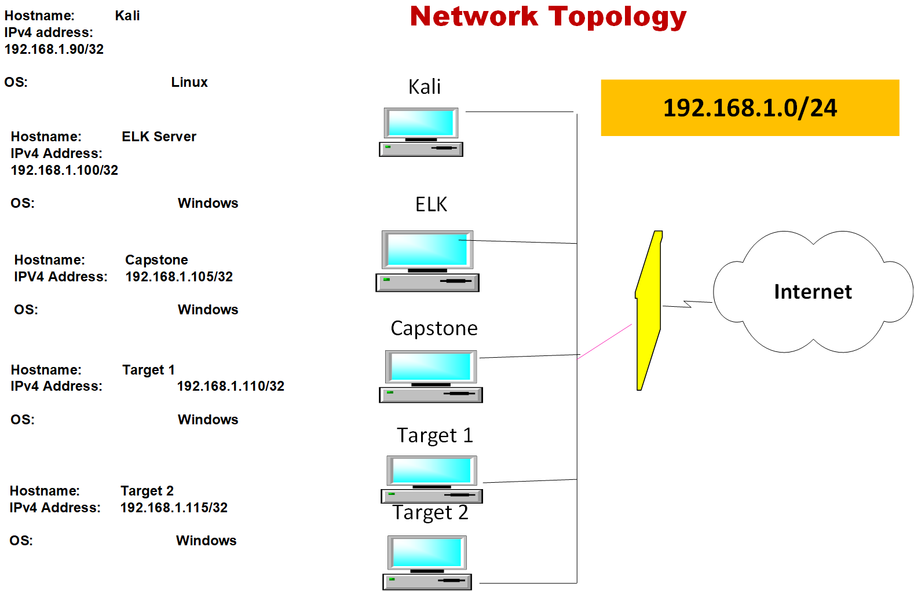
Hostname: Kali
IPv4 address: 192.168.1.90
OS: Linux
Hostname: ELK Server
IPv4 address: 192.168.1.100
OS: Windows
Hostname: Capstone
IPv4 Address: 192.168.1.105
OS: Windows
Hostname: Target 1
IPv4 Address: 192.168.1.110
OS: Windows
Hostname: Target2
IPv4 Address: 192.168.12.115
OS: Windows

Slide 5
Critical Vulnerabilities: Target 1
Our assessment uncovered the following critical vulnerabilities in Target 1.
Vulnerability | Description | Impact
SSH | 22/tcp | OpenSSH
HTTP | 80/tcp | Apache httpd 2.4
rpcbind | 111/tcp | 2-4
netbios-ssn | 139/tcp | samba smbd 3.x-4.x

Slide 6
Critical Vulnerabilities: Target 2
Our assessment uncovered the following critical vulnerabilities in Target 2.
Vulnerability | Description | Impact
SSH | 22/tcp | OpenSSH
HTTP | 80/tcp | Apache httpd 2.4.1
rpcbind | 111/tcp | 2,3,4
netbios-ssn | 139/tcp | Samba smbd 3.x-4.x

Slide 7

Exploits Used
Mitch Murov
7

Slide 8
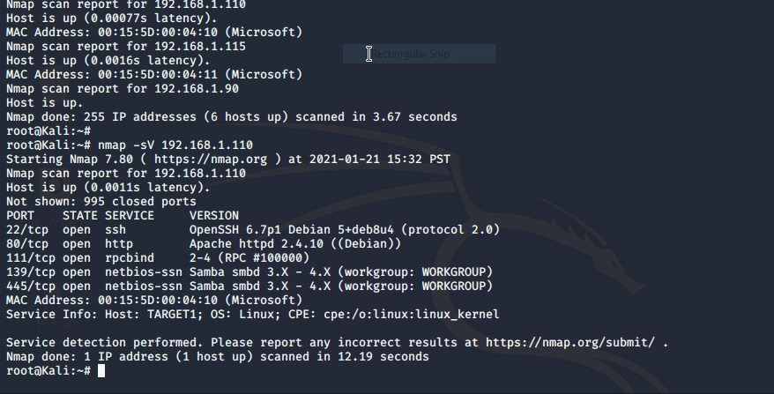
Exploitations
As we saw from nmap that there are several weaknesses to exploit, most notably ssh to gain a user shell and mysql.The next few slides will break down the major steps to this
I exploited the vulnerability by running nmap to find the ip and check open ports. We found that 198.162.1.110 had several open ports as discussed before.

Slide 9
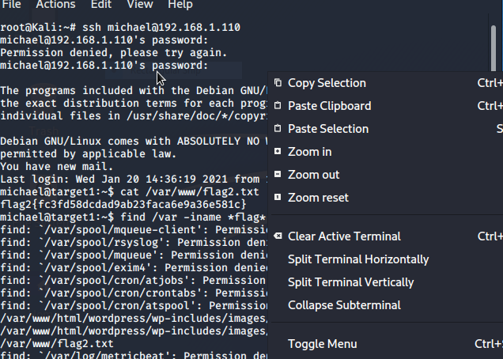
wpscan gave us two users michael and steven. We attempted to ssh into michael and found that. michael had a very weak, guessable password. Command wpscan –-url http://192.168.1.110/wordpress -eu

Slide 10
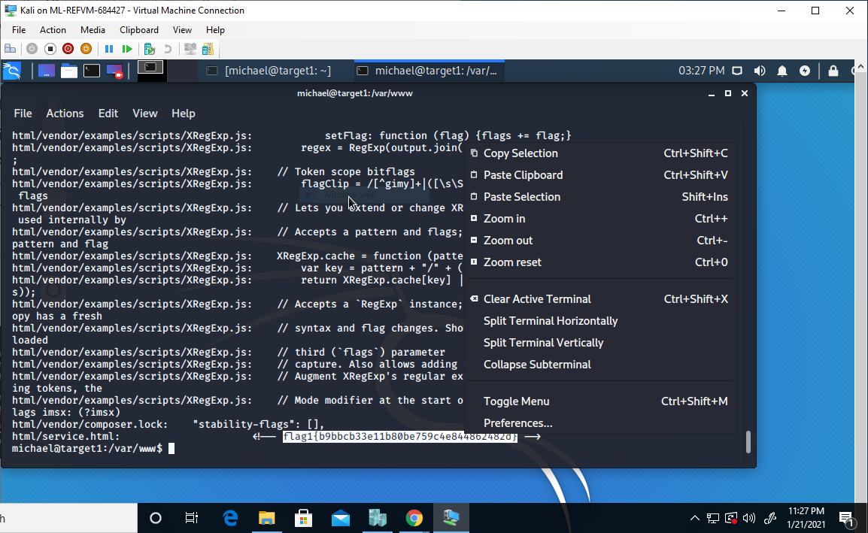
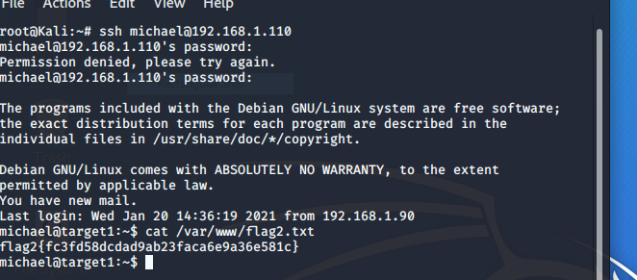
FLAGS
Flags 1 & 2 Shown Below:
*
*
*

Slide 11
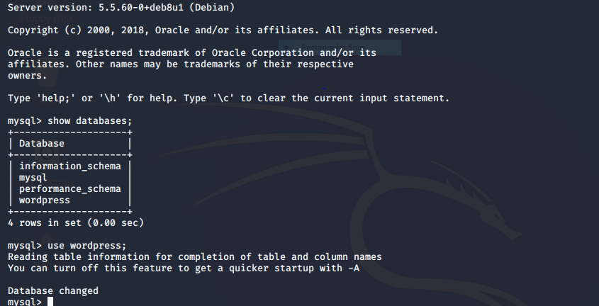
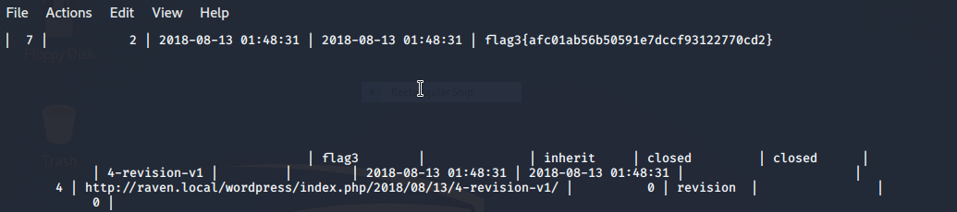
MYSQL Exploit into Wordpress database The wp_config .php file is easily readable to give us the username and password for MySql. I was able to switch to the wordpress database and get hashed user passwords.
The path on michael@target1: /var/www/html/wordpress/wp-config.php/wp-config.php.
Found username: root password: R@v3nsecurity
*

Slide 12
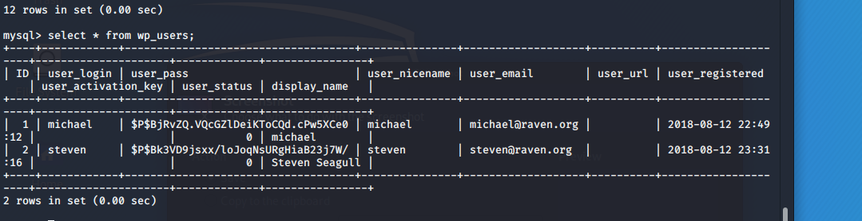
Output from wp_users. This was then run through nano and edited to create a text file wp_users.txt

Slide 13
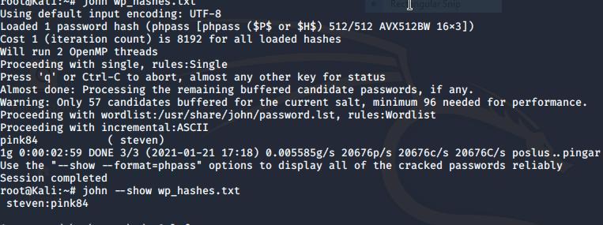
Use John the Cracker to crack user information from MYSQL
Put users from MYSQL through John. We find Steven has a password of pink84 which allows us to get control of steven

Slide 14
Take control of Steven and promote to root. Break into Raven Security
root@TARGET1:/ > id
uid=0(root) gid=0(root) groups=0(root)
root@TARGET1:/ > cd /root
root@TARGET1:/root > ls
flag4.txt
root@TARGET1:/ > id
uid=0(root) gid=0(root) groups=0(root)
root@TARGET1:/ > cd /root
root@TARGET1:/root > ls
flag4.txt
root@TARGET1:/root > cat flag4.txt

Slide 15
Take control of Raven Security
______
| ___ \
| |_/ /__ ___ _____ _ __
| / / _` \ \ / / _ \ '_ \
| |\ \ (_| |\ V / __/ | | |
\_| \_\__,_| \_/ \___|_| |_|
flag4{715dea6c055b9fe3337544932f2941ce}
CONGRATULATIONS on successfully rooting Raven!
*

Slide 16
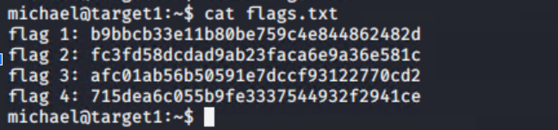
The Four Flags
These are the four flags found during the exploit

Slide 17

Avoiding Detection
Kevin Alvarado
17

Slide 18
Stealth Exploitation of SSH | Port 22
Monitoring Overview
Ssh logging in kibana
Which metrics do they measure? SSH attempts, traffic on port 22
Mitigating Detection
Create a user and escalate to root to privileges.
Register your IP as safe in infested computer for recognized access. (Public Key)

Slide 19
Stealth Exploitation of HTTP|Port 80
Monitoring Overview
HTTP REQUESTS/HTTP Errors.
Number of requests/errors per metric of time (Min/Hour).
400 errors in under 5 minutes/3.5kb in requests in under 1 min.
Mitigating Detection
Low and Slow attack

Slide 20

Maintaining Access
Symantha Meyers
20

Slide 21
Backdooring the Target
Backdoor Overview
I used 2 means of creating a backdoor to the target server (192.168.1.110 - Target 1)
1st backdoor
Changed the rights of the “steven” account to grant the user sudoer-level access
2nd backdoor
Created a new “sysd” account to mimic a system user account

Slide 22
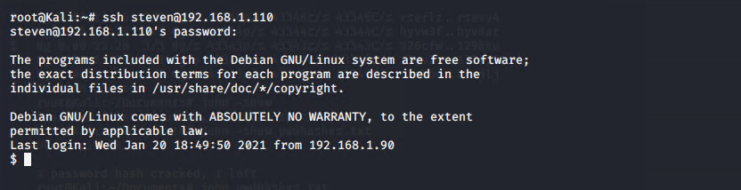
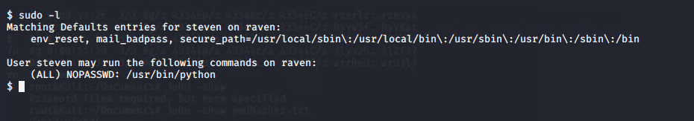
Backdooring the Target 1
Backdoor 1 - Escalating Privileges
Once the connection was made via SSH to the steven account, I typed sudo -l to view steven’s sudo privileges

Slide 23
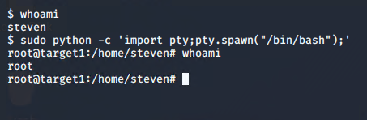
Backdooring the Target 1 part 2
Ran whoami to verify my current username
Ran sudo python -c ‘import pty;pty.spawn(“/bin/bash”);’ to escalate my privileges to root access.
Ran whoami to verify my new privileged status as “root”

Slide 24
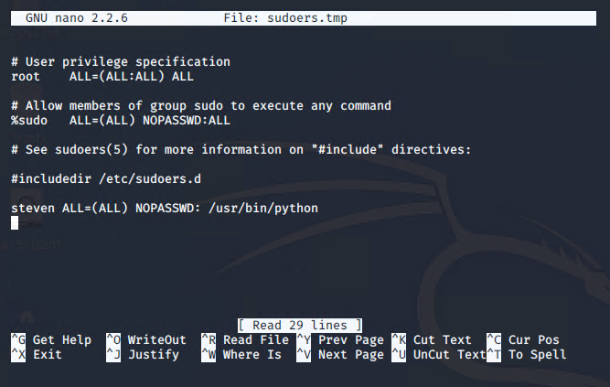
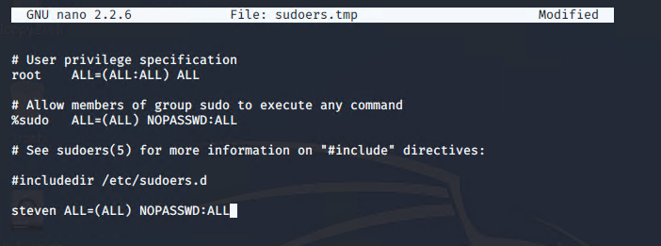
Backdooring the Target 1 (cont.)
Checked the sudoers file with sudo visudo -f sudoers to view steven’s access
Added full, root-level access to steven in the sudoers file to maintain access

Slide 25
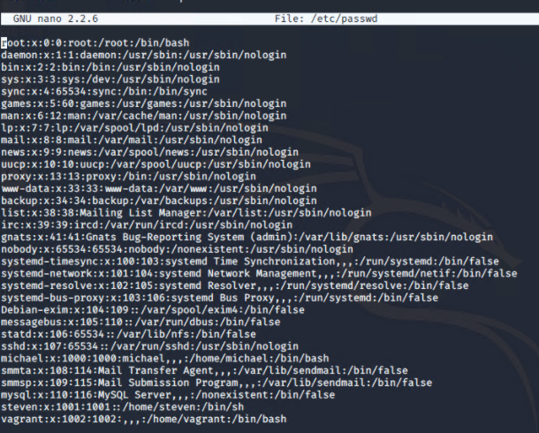
Backdooring the Target 1 (cont.)
Testing the Access
Exited the “root” account and ran whoami to verify I was back in the steven account, then ran sudo nano /etc/passwd to verify sudo access… success!

Slide 26
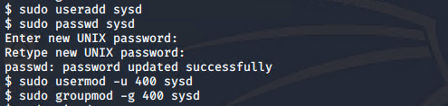
Backdooring the Target 2
Backdoor 2 - Create a new user account with a low UID
Created a user named “sysd” using sudo useradd sysd
Gave “sysd” a new, difficult-to-hack password (not telling you what it is)
Gave “sysd” a user id of 400
Gave “sysd” a group id of 400

Slide 27
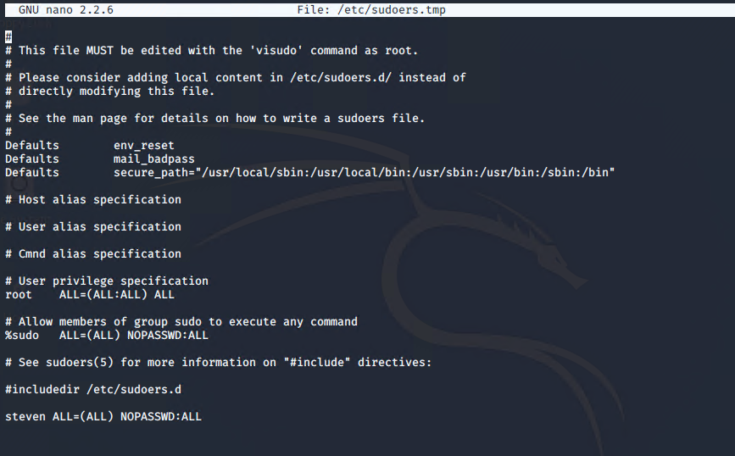
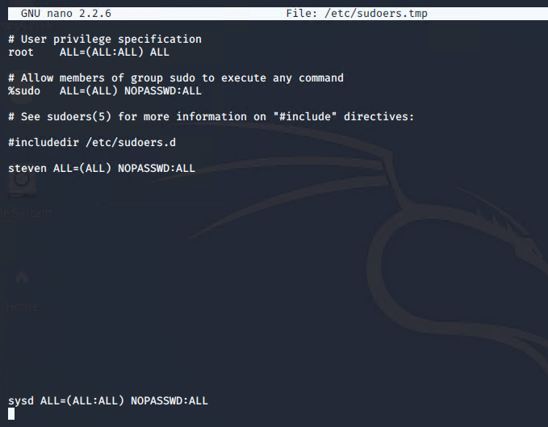
Backdooring the Target 2 (cont.)
Ran sudo visudo to modify the sudoers file
Created a new entry for the “sysd” user:
sysd ALL=(ALL:ALL) NOPASSWD:ALL

Slide 28
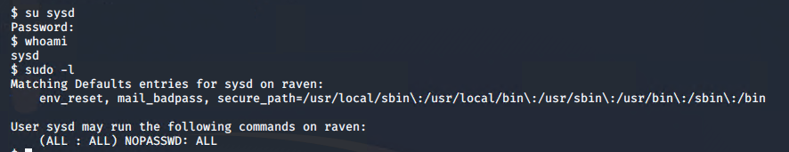
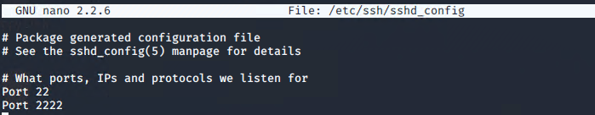
Backdooring the Target 2 (cont.)
Swapped to the new “sysd” user account and ran whoami to verify the
account in which I was logged in. Tested my new access by running
sudo -l to view my sudoer privileges
Then edited the sshd_config file to add a new ssh port (2222)

Slide 29
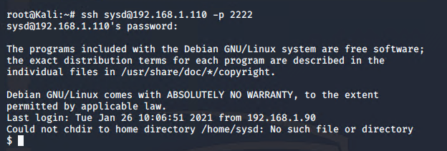
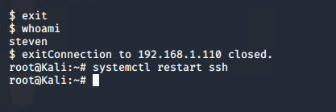

Backdooring the Target 2 (cont.)
Tested the new configuration and user account by exiting out of the steven account ssh session and restarting the SSH service
2) SSH’d into the target machine with the new sysd account on port 2222
3) Ran sudo su to escalate
privileges to root

Slide 30
Created By
Muhammed Jawara, Mitch Murov, Kevin Alvarado, and Symantha Meyers
Edited By
Symantha Meyers
Presented on January 26, 2021

